Slide 1
FACE RECOGNITION SYSTEM
By GROUP 24 – AKHIL (B160470CS)
ADWIN (B180481CS)
ANAGHA(B200762CS)
BHAGATH (B200770CS)

Slide 2
Introduction
The problem of Face Recognition has been tacked from a variety of directions in the past 20 years or so. Ample amount of research has been done on the Computer Vision problem of Face Recognition.
It is not a trivial task because a lot of factors like lighting, orientation, occlusion etc can change for the image of the same person.
Classical Methods that have been introduced so far are, Geometrical Feature Extraction, Eigen Faces, Fisher Faces, Local Binary Pattern Matching and A variety of deep learning learning models like FaceNet ,DeepFace etc that are trained on millions of images have also been introduced.

Slide 3
Objective
To create a deep learning model that uses “Transfer Learning” from VGG19architecture to classify images of two different subjects.
All the layers other than the fully connected layers of the VGG19 are selected and a global average pooling layer and 4 fully connected layers are added for training the model. All layers except the final layer has RELU as it’s activation function while the final layer uses a softmax activation for classification.
Input : An image of a person
Output: To correctly classify the image as belonging to a person in the database.

Slide 4
VGG19- CNN Architecture
The concept of the VGG19 ( convolutional neural network (CNN)) model is the same as the VGG16, except that it supports 19 layers). The “16” and “19” stand for the number of weight layers in the model (convolutional layers) .
Here, it contain 16 convolutional layers ,5 max pool layers,3 fully connected layers
VGG19 has three more convolutional layers than VGG16. The convolution layers extract features from the input images, and the fully connected layers classify the images based on those features.
It also has 5 maxpool layers incorporated in between to reduce the dimensions of the feature maps.
VGG19 was proposed by Simonyan and Zisserman in 2014. It was trained on the ImageNet database, which contains a million images of 1,000 categories. The pretrained network can classify images into 1,000 object categories, such as keyboard, mouse, pencil, and many animals.

Slide 5
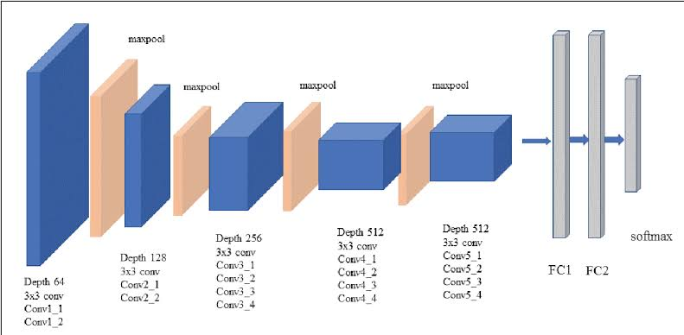
Height & Width: Pixel dimensions of your image Depth: Red, Green or Blue (3), or Black & White (1)

Slide 6
Methodology
A data set containing about 600 images of celebrities Angelina Jolie and Arnold Schwarzenegger is formed.
Step1 : The faces in the images is cropped using MTCNN deep network which is an implementation of the YOLO deep learning algorithm.
Step2: The data is again manually scanned for mislabelled images and correction are made.
Step3: The processed data is fed to the network. The model has been learned with both Adam and Rmsprop.
Step4: The trained model is then used for prediction of new images added to the system.

Slide 7
Result
The Architecture implemented achieved an 95.99% accuracy and loss of 0.134 with vgg19 as baseline model for classifying the images of Angelina Jolie and Arnold Schwarzenegger.
The results are sufficient considering the size of the data set that was used.

Slide 8
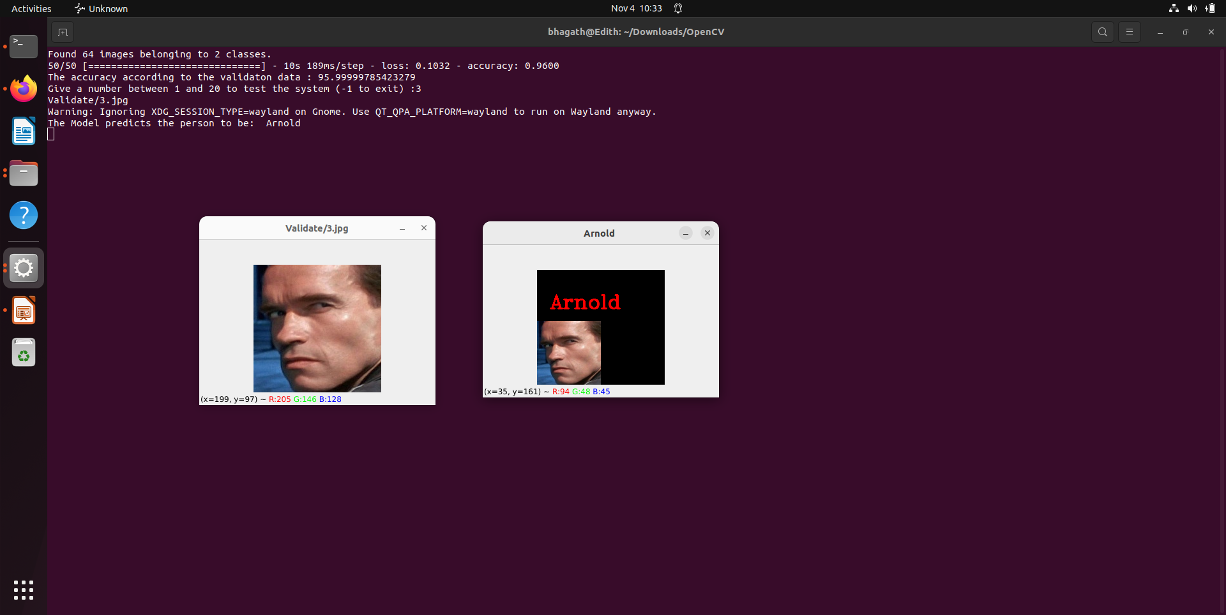

Slide 9
Conclusion
Face Recognition is a very complex task.
Convolutional neural networks are very good for image classification tasks.
A satisfactory accuracy was achieved with the implemented architecture.
The accuracy can be further increased by training the network much larger datasets.
The assignment worked as an introduction to data-driven methods of solutions to problems.

Slide 10
Reference
J. Xiang and G. Zhu, "Joint Face Detection and Facial Expression Recognition with MTCNN," 2017 4th International Conference on Information Science and Control Engineering (ICISCE), Changsha, China, 2017, pp. 424-427, doi: 10.1109/ICISCE.2017.95.
P. Viola and M. Jones, "Rapid object detection using a boosted cascade of simple features," Proceedings of the 2001 IEEE Computer Society Conference on Computer Vision and Pattern Recognition. CVPR 2001, Kauai, HI, USA, 2001, pp. I-I, doi: 10.1109/CVPR.2001.990517.
R. Ribani and M. Marengoni, "A Survey of Transfer Learning for Convolutional Neural Networks," 2019 32nd SIBGRAPI Conference on Graphics, Patterns and Images Tutorials (SIBGRAPI-T), Rio de Janeiro, Brazil, 2019, pp. 47-57, doi: 10.1109/SIBGRAPI-T.2019.00010.

